Slide 1


Diplomado Xamarin
Day 3

Slide 2




Hector Minaya
Megsoft Consulting
Email: hector@megsoftconsulting.com
Blog: https://medium.com/@hminaya
Twitter: @HectorMinaya

Slide 3

Agenda
Checklist
Day 2
Xamarin & Azure
Demo
Lab
info@megsoftconsulting.com

Slide 4
Before we begin - Checklist
MAC
PC
IDE
Xamarin Studio 6.2.1 or
Visual Studio for MAC Preview (latest)
Java
JDK 1.8.0_121
Android SDK
Android 6.0
iOS SDK
X Code 8.3
IDE
Visual Studio 2017 w/ Xamarin for Visual Studio or
Visual Studio 2015 w/ Xamarin for Visual Studio (4.3.0.795)
Java
JDK 1.8.0_121
Android SDK
Android 6.0
Mac?
If you plan on testing with iOS then you need network access to a Mac w/ X Code 8.3
info@megsoftconsulting.com

Slide 5
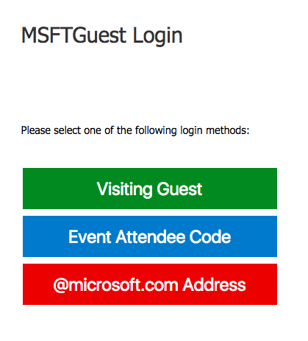
Wifi
SSID: MSFTGuest
Option: Visiting Guest
Username: user123@hotmail.com
Pass: 1856
info@megsoftconsulting.com

Slide 6
Day 2
Content
Materials
Xamarin Forms
PRISM
NavigationService
Commands
PageDialogService
http://bit.ly/DiplomadoXamarinDay2
https://github.com/hminaya/DiplomadoMSDay2
info@megsoftconsulting.com

Slide 7
Today!
info@megsoftconsulting.com

Slide 8
Demo
info@megsoftconsulting.com

Slide 9
Lab
info@megsoftconsulting.com

Slide 10
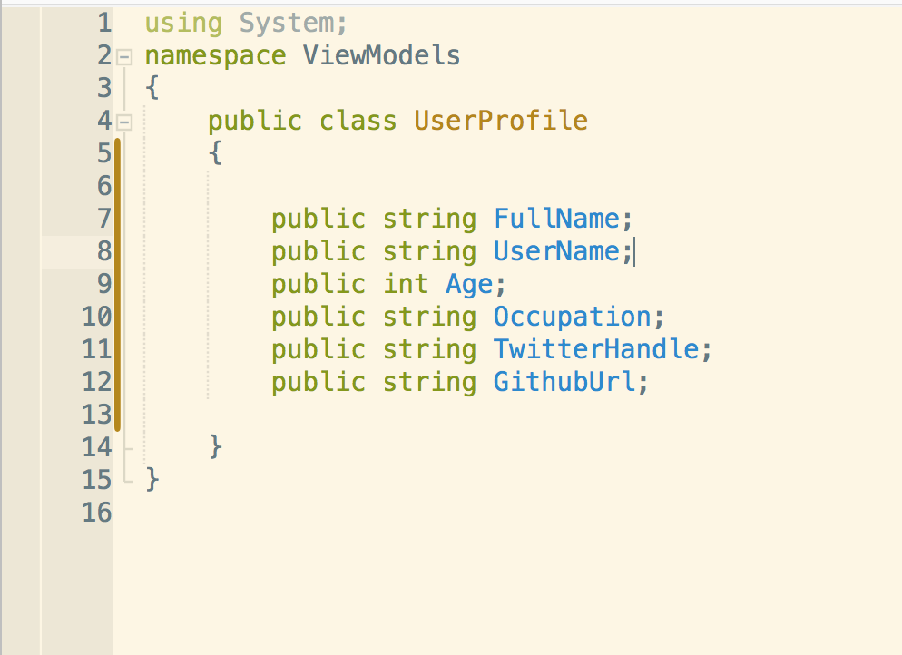
New Xamarin Forms App!
UserProfile
Edit Profile
About
Requirements
UserProfile.cs
HomeScreen
View all fields on UserProfile object
Edit button navigates to EditProfileScreen and sends UserModel
About button navigates to AboutScreen
EditProfileScreen
Edit UserProfile properties
Save button navigates back to HomeScreen and sends updated data
All fields should have valid data before navigating away
Cancel button navigates back to HomeScreen without saving data
AboutScreen
Your name, company, email
Ok button navigates back to HomeScreen
info@megsoftconsulting.com

Slide 11


